Slide 1
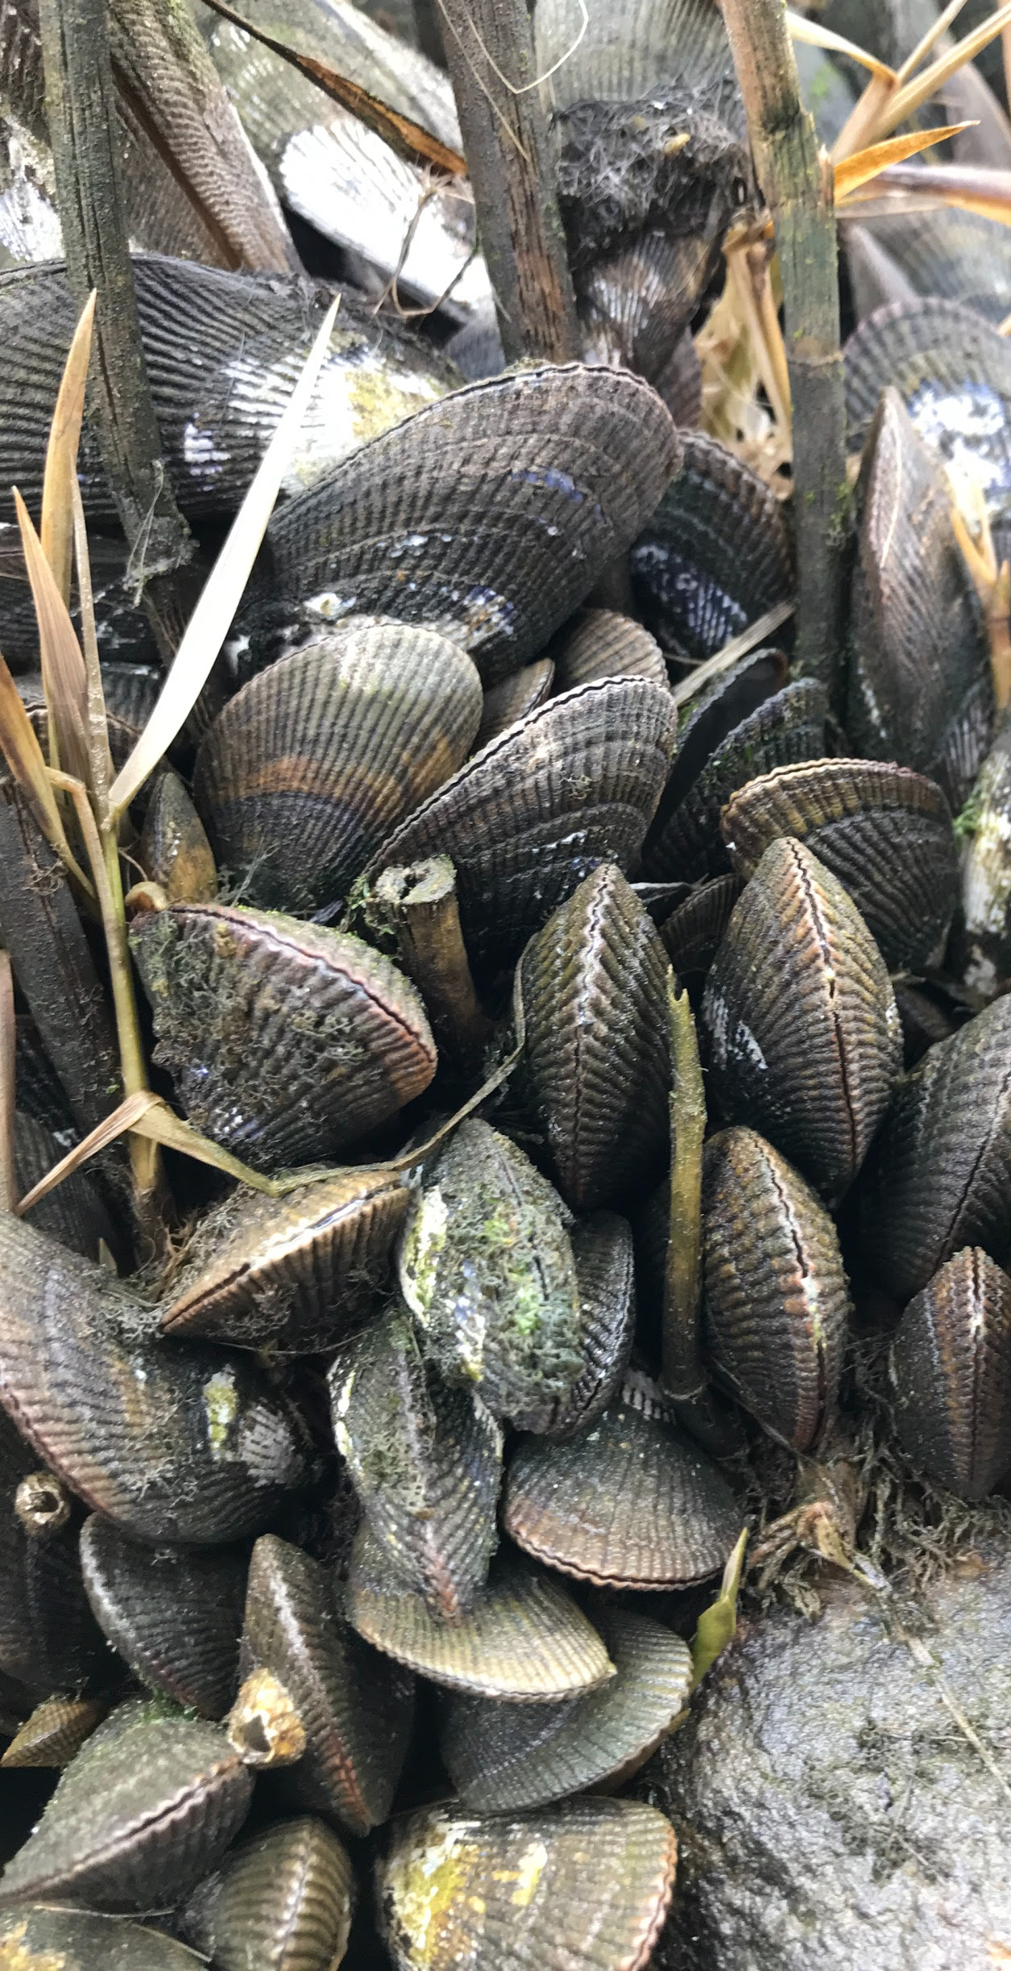
An Update on the Connecticut Shellfish Restoration Planning Project
Tessa L. Getchis, CT Sea Grant | UConn Extension
David Carey, CT Bureau of Aquaculture
Juliana Barrett, CT Sea Grant | UConn Extension
Harry Yamalis, CT DEEP
Kristin DeRosia-Banick, CT Bureau of Aquaculture
Gathering of Shellfish Commissions, February 13, 2021
Notes:
Good morning everyone. My name is Tessa Getchis and I am an extension educator with the Connecticut Sea Grant and UConn Extension Programs. This morning I am speaking on behalf of our team that is facilitating the development of a Shellfish Restoration Plan for Connecticut. We appreciate the invitation to talk with you about the work we’ve started and solicit your input.

Slide 2
Acknowledgements
Funding: USDA NRCS Conservation Innovation Grant and Pew Charitable Trusts
Project Steering Committee includes representatives from:
Audubon
Billion Oyster Project
CT Conservation Districts
CT Sea Grant
CT shellfish industry members
CT DA/BA
CT DEEP
CT River Conservancy
CT shellfish commissions
EPA LISS
Harbor Watch
NOAA Office of Fisheries
Michael Zuber, Cary Chadwick, Will Carta (GIS work)
Matt Hare, Katie McFarland (advice on genetics)
NOAA Office of Habitat
NOAA NEFSC Milford Lab & Regional Coord.
Sacred Heart University
Save The Sound
The Nature Conservancy
The Pew Charitable Trusts
The Sound School
UConn Extension
University of Connecticut
US Army Corps of Engineers
USDA NRCS
Notes:
I’d like to start by acknowledging the USDA Natural Resources Conservation Service who funded this work, and our steering committee comprised of individuals representing environmental groups, the Connecticut shellfish industry, local, state and federal regulators, scientists, educators and others. Many of them previously participating in the Long Island Sound Blue Plan process, and have been incredibly helpful in lending their expertise to this effort.

Slide 3
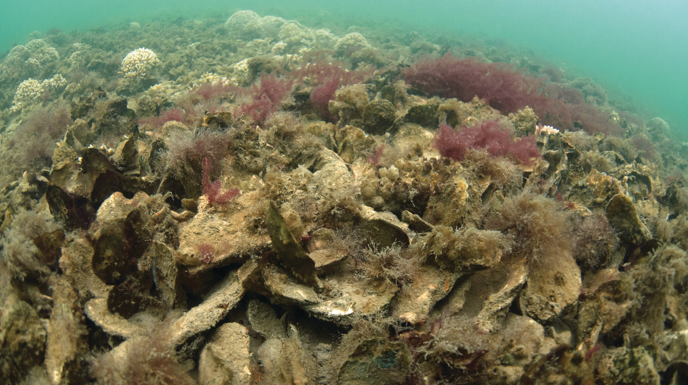
Photo: NOAA Fisheries
ecological benefits
Notes:
Shellfish beds provide considerable benefits to the ecosystem. Bivalve molluscs, especially reef-forming species, can provide habitat and structure, shoreline stabilization and erosion control and help improve water quality and clarity. For this project, we are particularly focused on the native Eastern oyster which can be found throughout the Sound, the ribbed mussel which grows along the fringes of salt marshes as tools for restoration. But there are other native bivalves such as northern quahog clams, bay scallops and blue mussels which are the target for aquaculture and fisheries production enhancement.

Slide 4
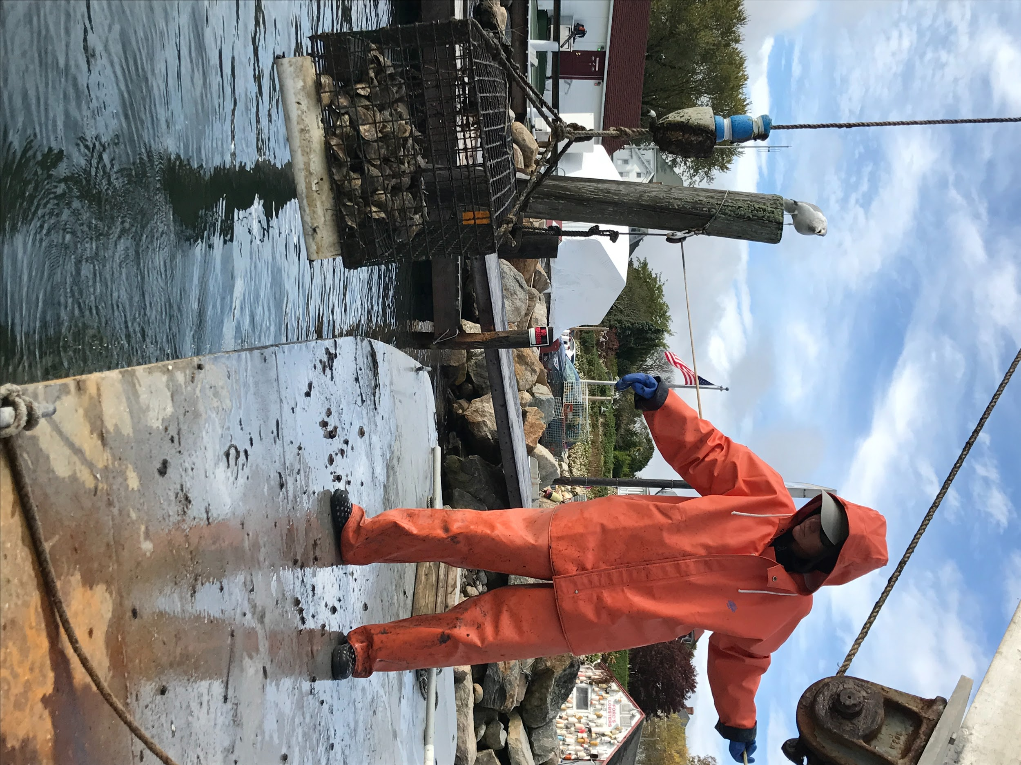
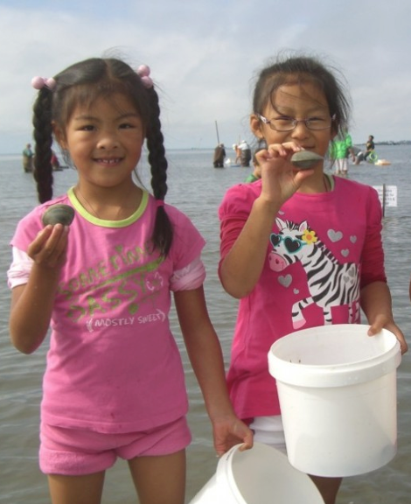
Photo: T. Getchis
Photo: Steve Straka
socioeconomic benefits
Notes:
And that is because those shellfish populations provide significant economic and cultural benefits.
We have a $30 million dollar aquaculture industry that produces oysters, clams, mussels and scallops.
There are more than 50 companies and 300 employees that depend upon shellfish to make a living.
And there are 15 coastal towns that manage recreational harvest areas.
From Stonington to Greenwich, these commissions sell tens of thousands of permits a year, which adds up to more than $100,000 in revenue for the local economy.

Slide 5
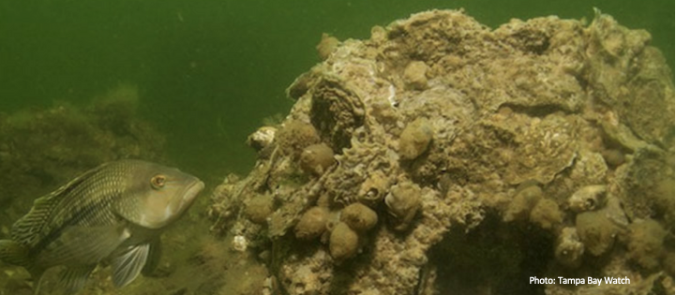
restoration goals
improve habitat for reef formation
improve water quality
shoreline stabilization and erosion control
Increase aquaculture production
Increase recreational harvest
Tampa Bay Watch
Notes:
The steering committee identified five broad restoration goals for Connecticut including:
Improving habitat for marine organisms as well as settlement habitat for shellfish bed development
Using shellfish as a tool to Improve water quality
Where possible, using shellfish as a means to stabilize the shoreline and prevent erosion
And to increase aquaculture and recreational shellfisheries production

Slide 6
Project Objectives
Identify potential, suitable and optimal areas for all types of shellfish restoration
Map viewer
Exclusionary Analysis
Habitat Suitability Analysis
Identify best practices for site selection, materials, monitoring, construction, evaluation
Establish regulatory guidance
Identify data needs for future work
Notes:
And as I alluded to before, we want to have a better understanding of the full extent of our shellfish resources, and the environmental and human context in which shellfish populations can thrive.
This project involves a GIS analysis that we’ve just begun to help us identify areas that are suitable and optimal for shellfish production.
The endpoint is a plan that that provides best practices and regulatory guidance for restoration, and a site selection tool to allow practitioners to access environmental and human use data and a shellfish restoration layer indicating the best places for restoration to occur.
The anticipated outcomes of this project are that restoration practitioners will have better information and tools for restoration which may facilitate permitting and project success, and that funding agencies with have confidence that they are funding high priority, state-supported efforts which may facilitate investment.

Slide 7
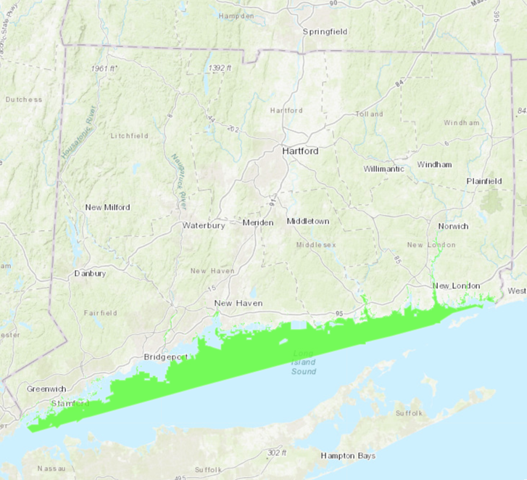
Exclusionary Analysis
First step eliminated all shellfish areas; what remains is nearly 80% of area or 308,840 acres*
*The preliminary dataset is from CT DEEP Hydrology and CT DABA shellfish data layers as of 10/2020; includes all CT waters except commercial, recreational, managed natural shellfish beds
Potential area (preliminary)

Slide 8
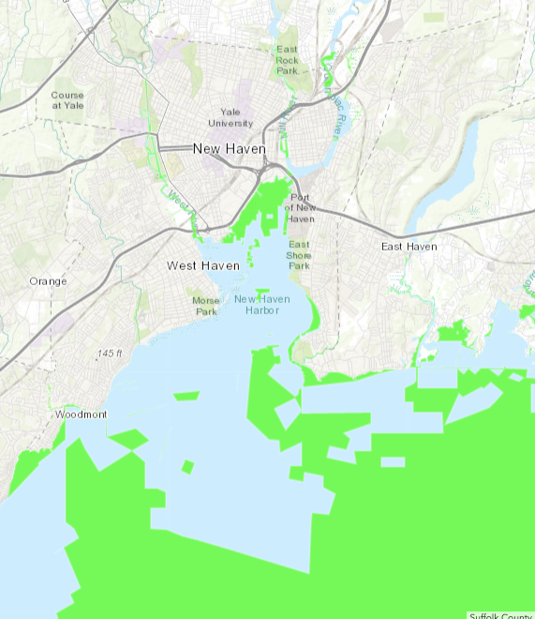
Exclusionary Analysis
The second step will eliminate areas that are have regulatory restrictions, e.g. navigation channels, shipping lanes, essential fish habitat areas, etc.
(IN PROGRESS)
Potential area (preliminary)
Notes:
If we zoom in, you’ll see that this still leaves a lot of potential area to work in. But this is just the start of the anlaysis. There are also other activities or zones in which restoration are be restricted and those will be eliminated in the next step of the analysis which is underway now. Here are a few examples:

Slide 9
Map Viewer
https://uconnclear.maps.arcgis.com/apps/MapSeries/index.html?appid=66619b7eedea4cfdb356bc5618ab4b01
Notes:
And as I alluded to before, we want to have a better understanding of the full extent of our shellfish resources, and the environmental and human context in which shellfish populations can thrive.
This project involves a GIS analysis that we’ve just begun to help us identify areas that are suitable and optimal for shellfish production.
The endpoint is a plan that that provides best practices and regulatory guidance for restoration, and a site selection tool to allow practitioners to access environmental and human use data and a shellfish restoration layer indicating the best places for restoration to occur.
The anticipated outcomes of this project are that restoration practitioners will have better information and tools for restoration which may facilitate permitting and project success, and that funding agencies with have confidence that they are funding high priority, state-supported efforts which may facilitate investment.

Slide 10
Notes:
And as I alluded to before, we want to have a better understanding of the full extent of our shellfish resources, and the environmental and human context in which shellfish populations can thrive.
This project involves a GIS analysis that we’ve just begun to help us identify areas that are suitable and optimal for shellfish production.
The endpoint is a plan that that provides best practices and regulatory guidance for restoration, and a site selection tool to allow practitioners to access environmental and human use data and a shellfish restoration layer indicating the best places for restoration to occur.
The anticipated outcomes of this project are that restoration practitioners will have better information and tools for restoration which may facilitate permitting and project success, and that funding agencies with have confidence that they are funding high priority, state-supported efforts which may facilitate investment.

Slide 11
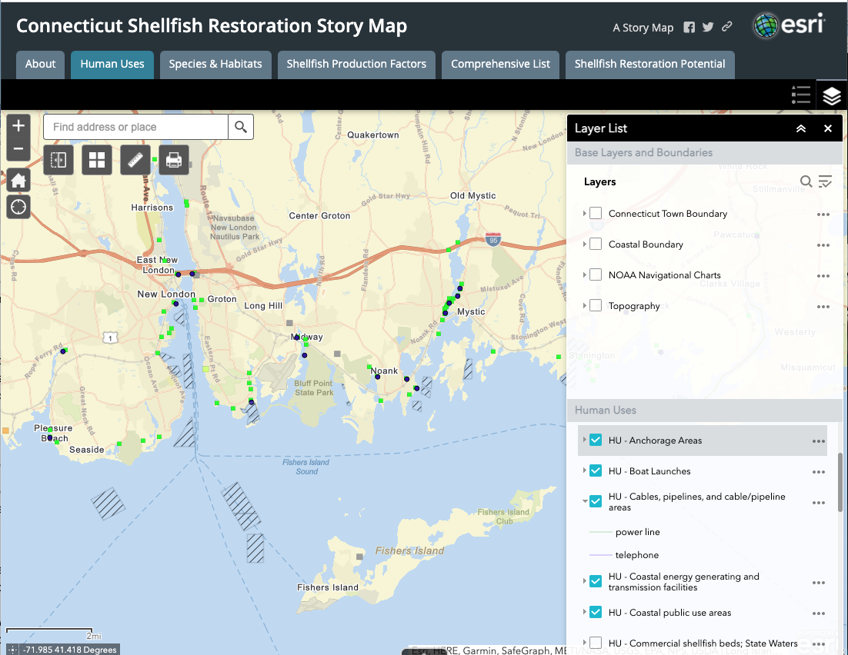
Notes:
And as I alluded to before, we want to have a better understanding of the full extent of our shellfish resources, and the environmental and human context in which shellfish populations can thrive.
This project involves a GIS analysis that we’ve just begun to help us identify areas that are suitable and optimal for shellfish production.
The endpoint is a plan that that provides best practices and regulatory guidance for restoration, and a site selection tool to allow practitioners to access environmental and human use data and a shellfish restoration layer indicating the best places for restoration to occur.
The anticipated outcomes of this project are that restoration practitioners will have better information and tools for restoration which may facilitate permitting and project success, and that funding agencies with have confidence that they are funding high priority, state-supported efforts which may facilitate investment.

Slide 12
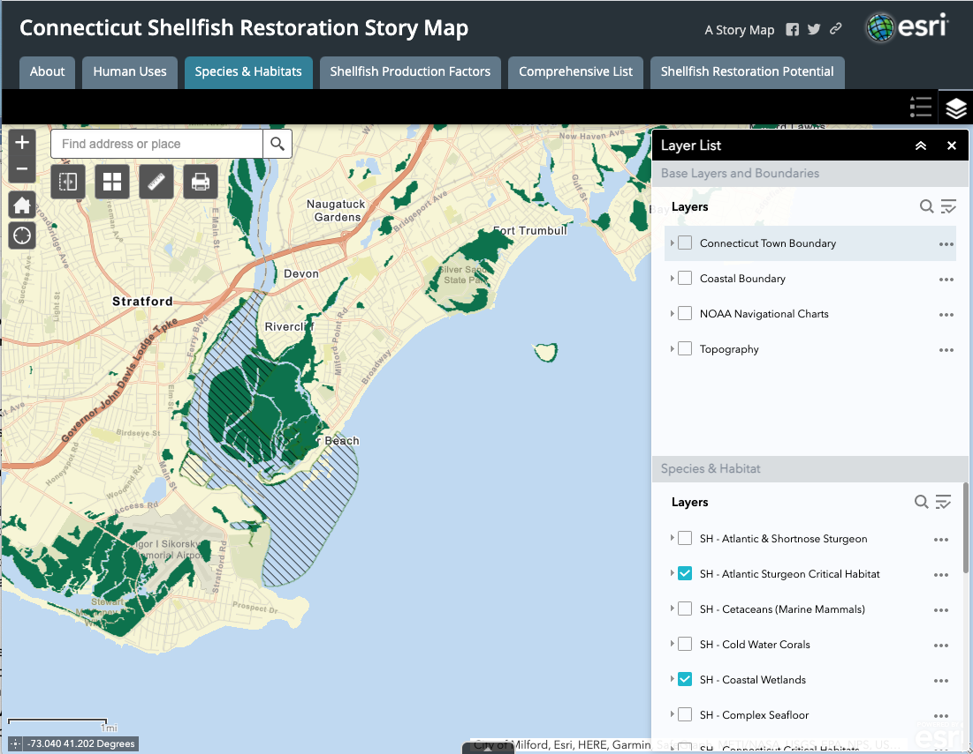
Notes:
And as I alluded to before, we want to have a better understanding of the full extent of our shellfish resources, and the environmental and human context in which shellfish populations can thrive.
This project involves a GIS analysis that we’ve just begun to help us identify areas that are suitable and optimal for shellfish production.
The endpoint is a plan that that provides best practices and regulatory guidance for restoration, and a site selection tool to allow practitioners to access environmental and human use data and a shellfish restoration layer indicating the best places for restoration to occur.
The anticipated outcomes of this project are that restoration practitioners will have better information and tools for restoration which may facilitate permitting and project success, and that funding agencies with have confidence that they are funding high priority, state-supported efforts which may facilitate investment.

Slide 13
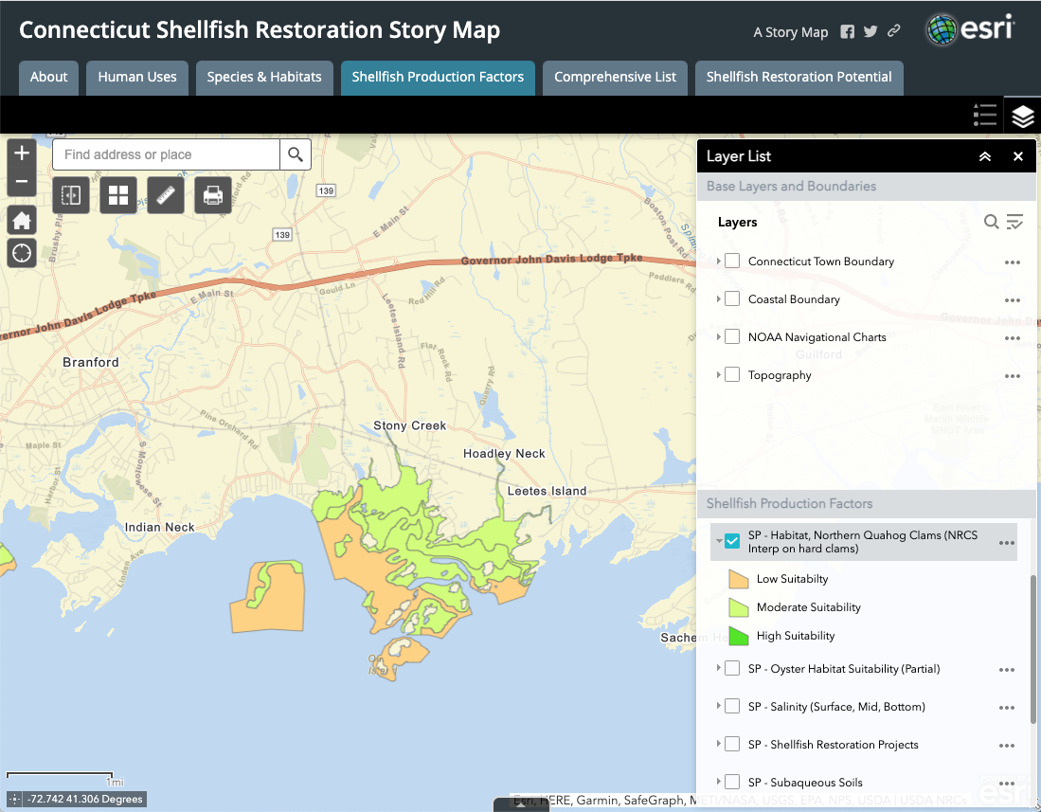
Notes:
And as I alluded to before, we want to have a better understanding of the full extent of our shellfish resources, and the environmental and human context in which shellfish populations can thrive.
This project involves a GIS analysis that we’ve just begun to help us identify areas that are suitable and optimal for shellfish production.
The endpoint is a plan that that provides best practices and regulatory guidance for restoration, and a site selection tool to allow practitioners to access environmental and human use data and a shellfish restoration layer indicating the best places for restoration to occur.
The anticipated outcomes of this project are that restoration practitioners will have better information and tools for restoration which may facilitate permitting and project success, and that funding agencies with have confidence that they are funding high priority, state-supported efforts which may facilitate investment.

Slide 14
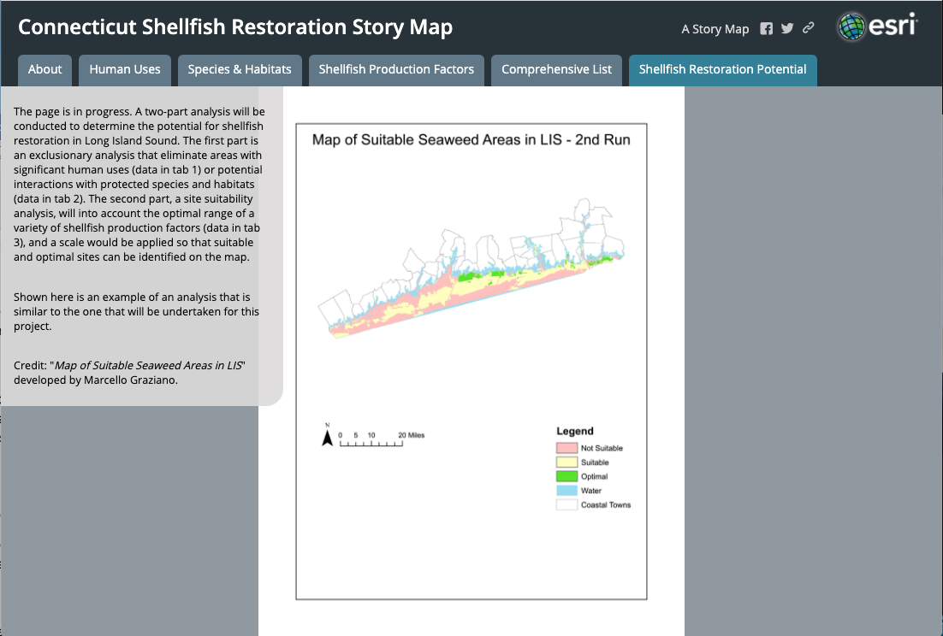
Notes:
And as I alluded to before, we want to have a better understanding of the full extent of our shellfish resources, and the environmental and human context in which shellfish populations can thrive.
This project involves a GIS analysis that we’ve just begun to help us identify areas that are suitable and optimal for shellfish production.
The endpoint is a plan that that provides best practices and regulatory guidance for restoration, and a site selection tool to allow practitioners to access environmental and human use data and a shellfish restoration layer indicating the best places for restoration to occur.
The anticipated outcomes of this project are that restoration practitioners will have better information and tools for restoration which may facilitate permitting and project success, and that funding agencies with have confidence that they are funding high priority, state-supported efforts which may facilitate investment.

Slide 15
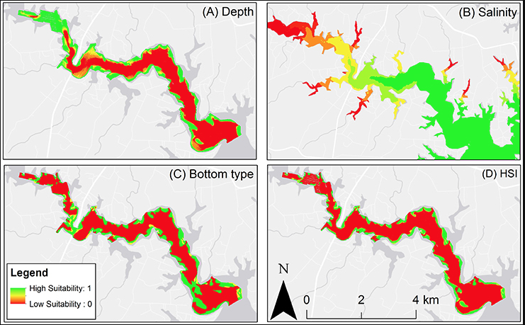
Mississippi
Notes:
These types of efforts can take into account a variety of different shellfish production factors that are analyzed here separately, and then together into one HSI product.

Slide 16
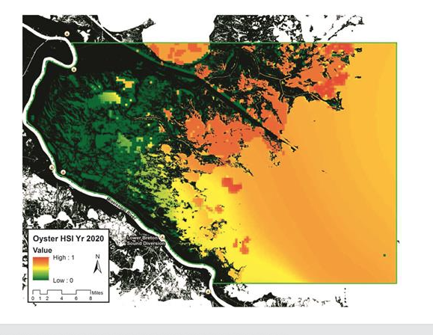
Mississippi

Slide 17
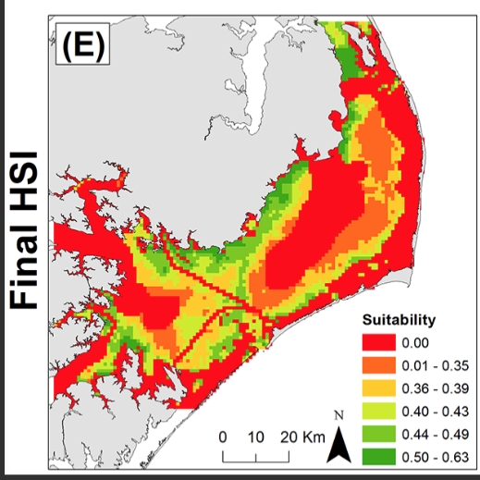
North Carolina

Slide 18
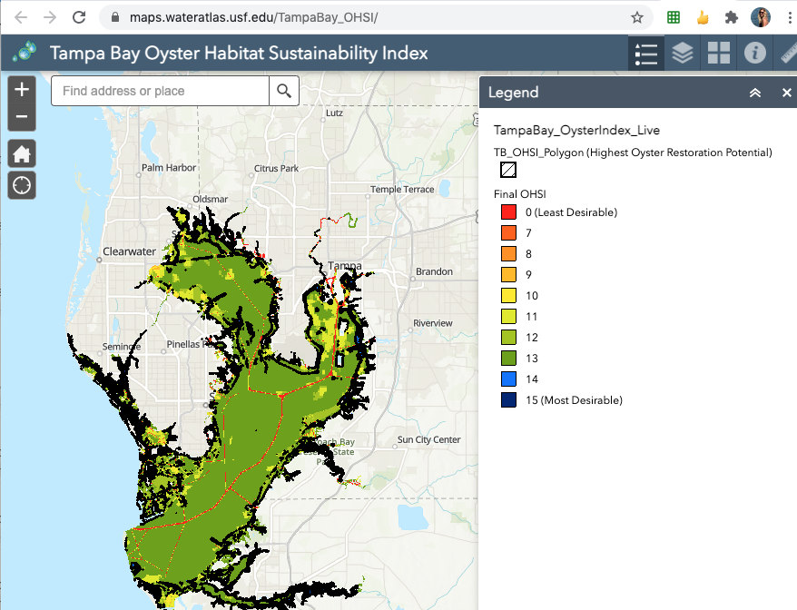
Florida

Slide 19
Next Steps
Exclusionary Analysis (February)
Site suitability analysis (March)
Identification of priority sites (Spring)
Best practices (in progress)
Regulatory guidance (in progress)
Final plan and map viewer (September 2021)
Notes:
We’re just beginning this process, but have learned a lot from previous shellfish restoration planning efforts and we are benefitting from the expertise of our diverse steering committee. So now I’m going to switch gears a bit and talk about a rehabilitation project that took place on the natural shellfish beds earlier this year.

